Slide 1
PSS 13 Implicit Integrators
Computer exercises:
8.3: Code implicit Euler scheme + Van der Pol
8.5: Find Butcher tableaux from Gauss-Legendre collocation method

Slide 2
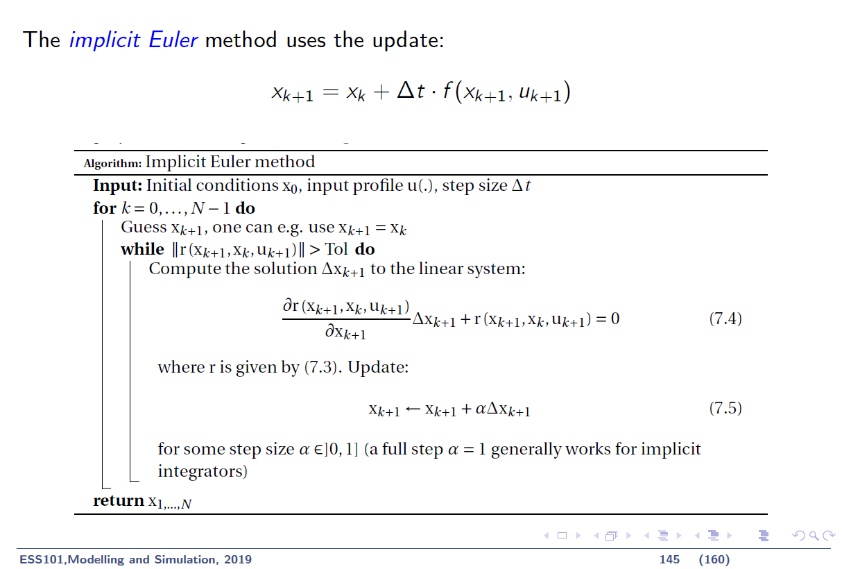
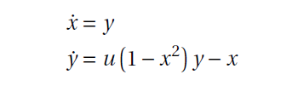
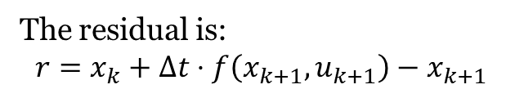
1) Exercise 8.3 – Implicit Euler on Van der Pol
Van der Pol equations :
with u = 5.
The residual is:
$$r=x_{k}+Δt⋅f\left(x_{k+1},u_{k+1}\right)−x_{k+1}$$

Slide 3
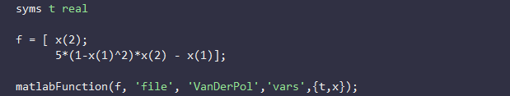
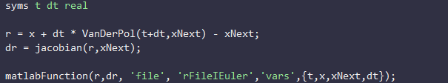

1) Exercise 8.3 – Implicit Euler on Van der Pol
Solution :

Slide 4
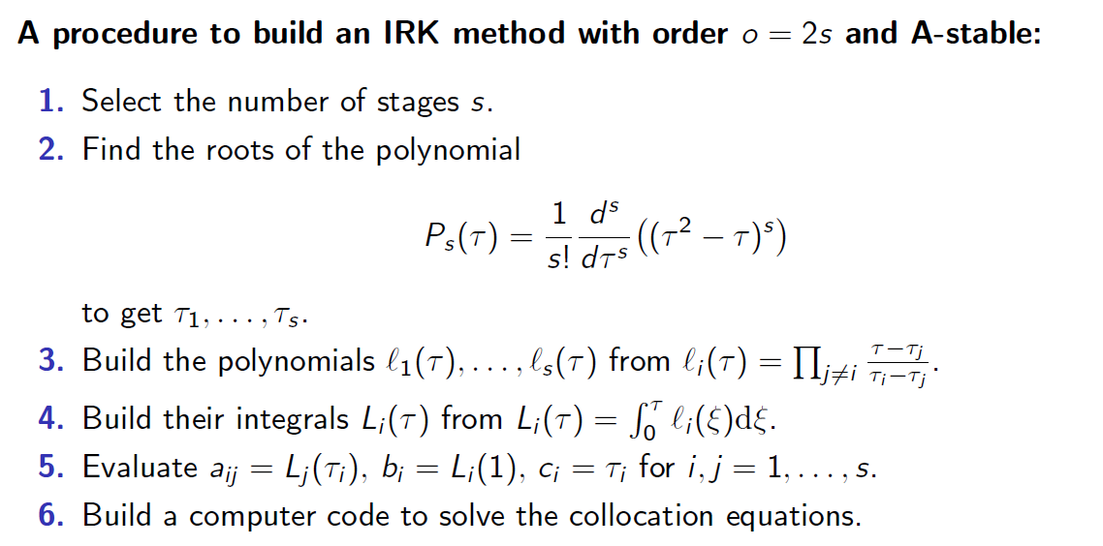
2) Exercise 8.5 – Gauss-Legendre method
Useful Matlab functions:
diff, solve, sort
int
subs, simplify

Slide 5
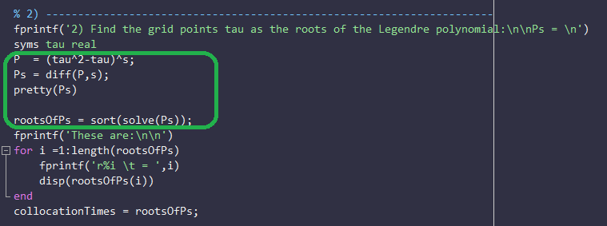
2) Exercise 8.5 – Gauss-Legendre method

Slide 6
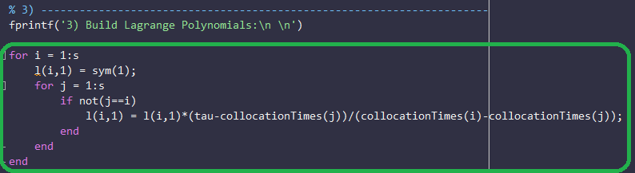
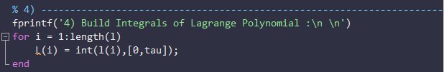
2) Exercise 8.5 – Gauss-Legendre method

Slide 7
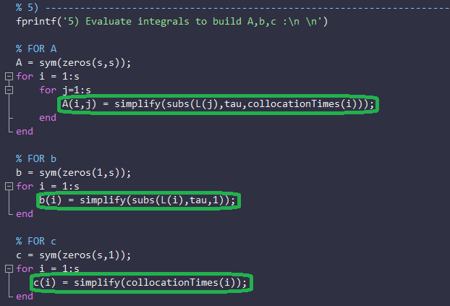
2) Exercise 8.5 – Gauss-Legendre method

